Slide 1
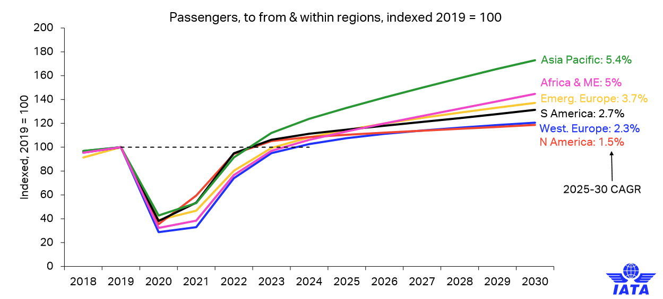
m1nd-set´s b1s recovery monitor – Latin America
M1nd-set partner IATA shares a positive long-term view for post-COVID-19 passenger demand recovery which underlines the assertion that people remain eager to travel by air in the short and long term.
The highlights of their forecasts include:
In 2021 global passenger numbers are expected to recover to 52% of pre-COVID-19 levels (2019).
In 2022 global passenger numbers are expected to recover to 88% of pre-COVID-19 levels.
In 2023 global passenger numbers are expected to surpass pre-COVID-19 levels (105%).
By 2030 global passenger numbers are expected to have grown to 5.6 billion. That would be 7% below the pre-COVID-19 forecast and an estimated loss of 2-3 years of growth due to COVID-19.
Regions with large domestic markets recover first.
European, Africa & Middle East regions lags due to international markets.

Slide 2
m1nd-set´s b1s recovery monitor – Latin America
International departures from Latin America
PAX in millions of passengers and Y.O.Y Growth
2019
2020
2021
2022
2023
-68%
+12%
+106%
+44%
116
37
41
84
121
International departures: Global and from Latin America
PAX in millions of passengers

Slide 3
m1nd-set´s b1s recovery monitor – Latin America
FOOTFALL AND CONVERSION
TOP 5 CATEGORIES THAT BECAME MORE POPULAR IN 2021
TOTAL
TOTAL
TOTAL
TOTAL
TOTAL
CLOTHING & ACCESSORIES
TOTAL
10%
3%
42%
66%
41%
59%
41%
57%
40%
52%
37%
59%
TOTAL
TOBACCO
8%
4%
TOTAL
SKINCARE
8%
4%
JEWELLERY & WATCHES
TOTAL
7%
3%
SALES STAFF
TOTAL
55%
TOTAL
72%
TOYS
6%
1%
TOTAL
TOTAL
TOTAL
TOTAL
80%
51%
50%
49%
47%
54%
52%
51%
44%
KEY PURPOSE OF PURCHASE
TOTAL
49%
TOTAL
31%
TOP 3 TOUCH POINTS THAT BECAME MORE IMPORTANT IN 2021
TOTAL
TOTAL
14%
OFFICIAL BRAND’S WEBSITE / APP
… on average (all years)
… in 2021
28%
6%
DOWNTOWN SHOP’S WEBSITE / APP
… on average (all years)
22%
TOTAL
… in 2021
9%
Gifting
Self-purchases
Sharing
ADS IN MAGAZINES
… on average (all years)
21%
TOTAL
… in 2021
2%

